Slide 1
MOLECULAR BIOLOGY LABORATORY
BT 453
Laboratory No. 4
Polymerase Chain Reaction I
MBL. BT453

Slide 2
OBJECTIVES
Understand how the polymerase chain reaction works
Understand the calculations needed to carry out a PCR experiment.
To get an idea about the various application of this technique.
MBL. BT453

Slide 3
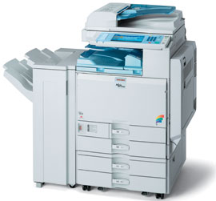
What is the Polymerase Chain Reaction?
It’s a means of selectively amplifying a particular segment of DNA
The segment may represent a small part of a large and complex mixture of DNAs:
e.g. a specific exon of a human gene
It can be thought of as:
Molecular Photocopier
MBL. BT453

Slide 4

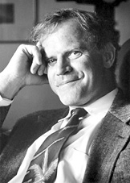
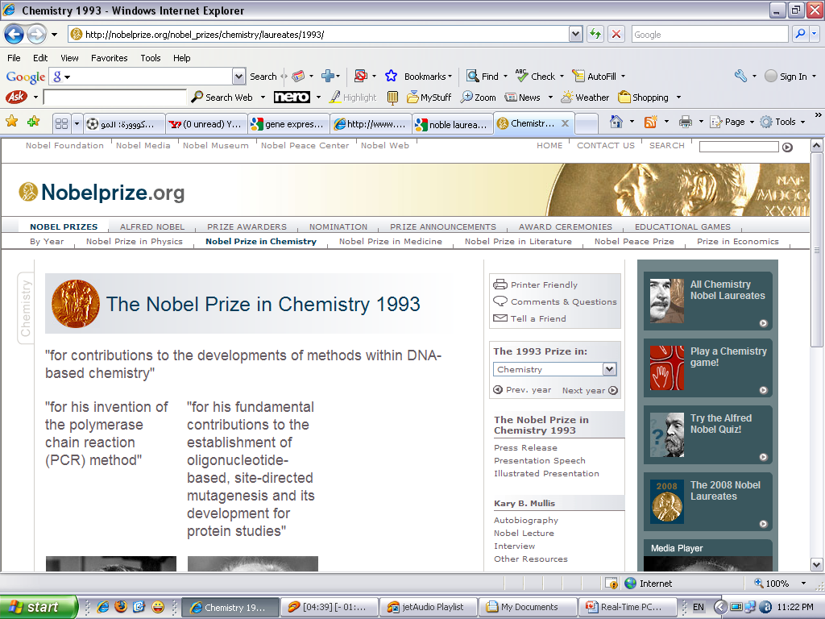
The man who invented the PCR?
Kary B. Mullis
The Nobel Prize in Chemistry 1993
MBL. BT453

Slide 5
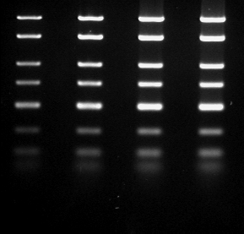
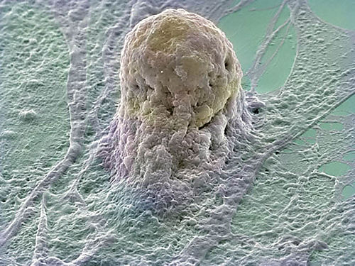
How Powerful is the PCR?
PCR can amplify a usable amount of DNA (visible by gel electrophoresis) in ~2 hours.
The PCR product can be digested with restriction enzymes, sequenced or cloned.
- PCR can amplify a single DNA molecule
e.g. from a single cell.
MBL. BT453

Slide 6
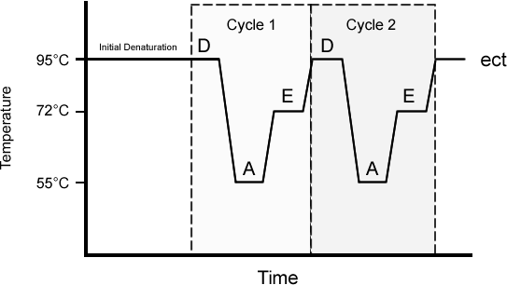
The Basics of PCR Cycling
30–35 cycles each comprising:
1- Denaturation (95°C), 30 - 60 sec.
2- Annealing (55–65°C), 30 - 60 sec.
3- Extension (72°C), time depends on product size.
MBL. BT453

Slide 7
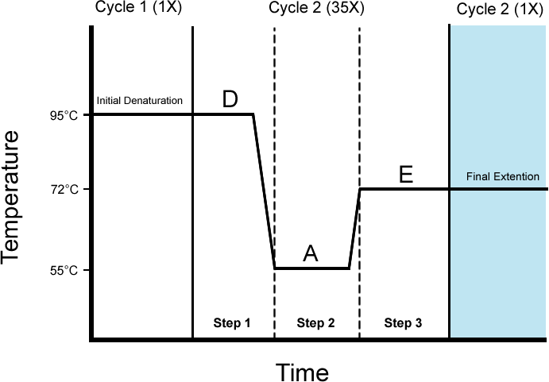
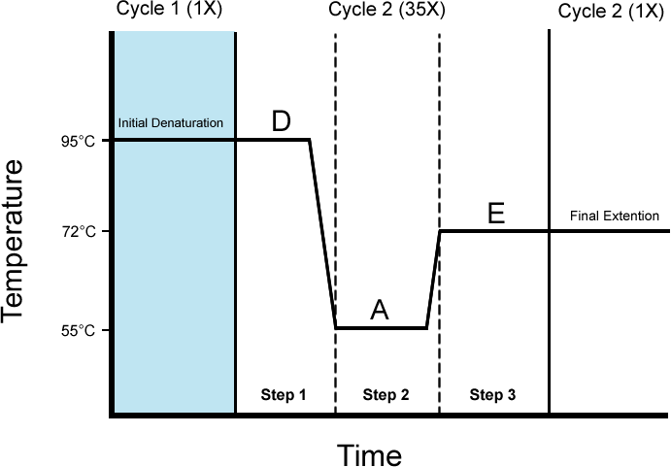
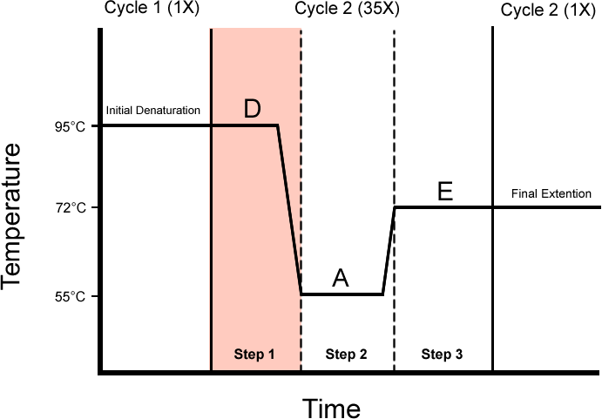
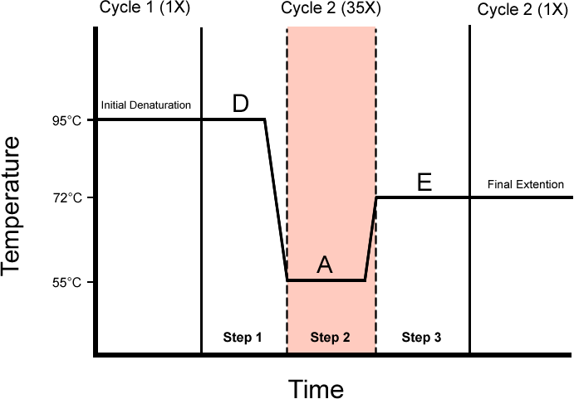
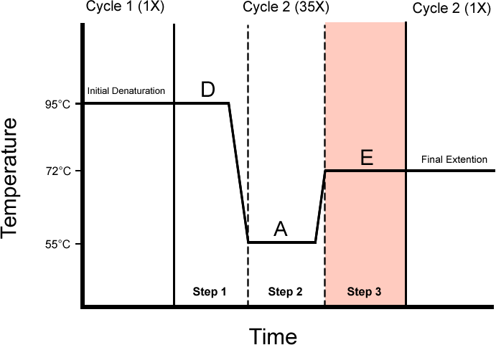
The Basics of PCR Cycling
30–35 cycles each comprising:
1- Denaturation (95°C), 30 - 60 sec.
2- Annealing (55–65°C), 30 - 60 sec.
3- Extension (72°C), time depends on product size.
MBL. BT453

Slide 8


What is in the reaction ?
Template DNA
Reaction buffer
MgCl₂
Nucleotides (dNTPs)
Forward & Reverse Primers
DNA polymerase
MBL. BT453

Slide 9

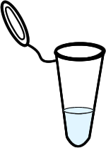
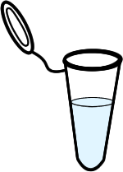

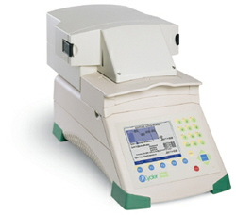
Reverse Primer
Nucleotides
Forward Primer
DNA
DNA Polymerase
Thermal Cycler
Reaction tube
MBL. BT453

Slide 10
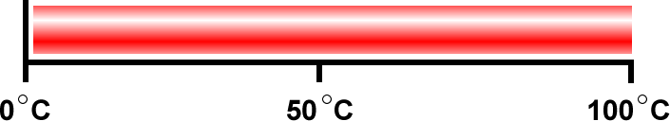

Denaturation
Annealing
Thermal Cycler
25°C
95°C
65°C
MBL. BT453

Slide 11
Extension
Annealing
Thermal Cycler
72°C
65°C
MBL. BT453

Slide 12
MBL. BT453

Slide 13
MBL. BT453

Slide 14


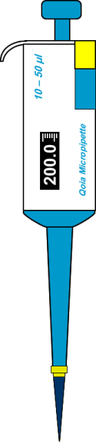
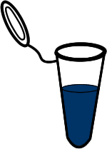
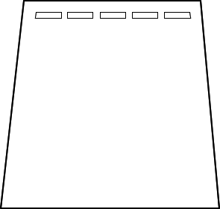

Loading the samples into the gel
Mixing with Loading Dye
Agrose Gel
MBL. BT453

Slide 15

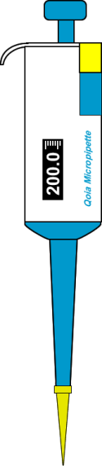

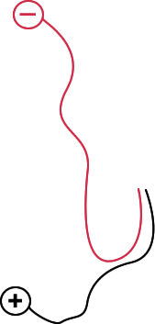

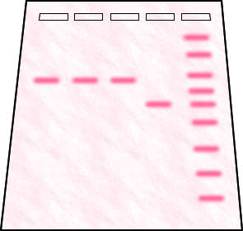
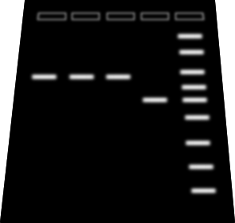

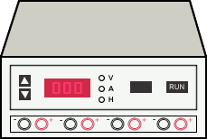
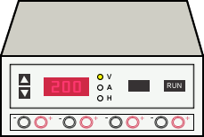
Loading the samples into the gel
UV Detection
Running the Gel
Gel Documentation System
Cathode
Power Supply
Agrose Gel
Anode
MBL. BT453

Slide 16
Let’s do a PCR experiment
Component | Stock concentration | Concentration in the reaction
Buffer | 10 X | 1 X
MgCl₂ | 25 mM | 3 mM
dNTPs | 10 mM | 0.2 mM
Polymerase | 10 U / µL | 5 U
Primers | 10 pmol | 0.5 pmol
Nuclease-free H₂O | - | Variable
MBL. BT453

Slide 17
Calculations
C1 X V1 = C2 X V2
PCR reaction volume = 25 – 100 µl :
Template DNA
Reaction buffer
MgCl₂
Nucleotides (dNTPs)
Forward & Reverse Primers
DNA polymerase
Nuclease-free H₂O
MBL. BT453

Slide 18
Calculations
C1 X V1 = C2 X V2
Concentration of stock
e.g. MgCl₂ = 50 mM
Final concentration in the PCR reaction
e.g. MgCl₂ = 1 mM
Volume of the reaction
e.g. 25 µl
Volume needed from the stock solution
e.g. MgCl₂ = 2 µl
MBL. BT453

Slide 19
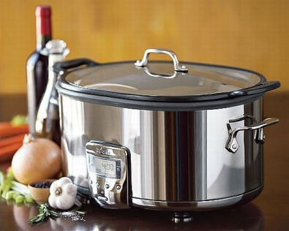
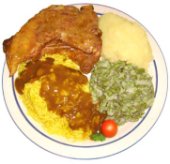
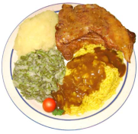
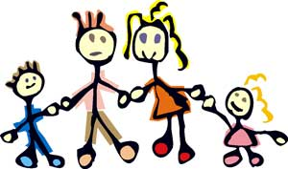
Master Mix
Extra
For a guest ?!
MBL. BT453

Slide 20
Master Mix
Master Mix
Reaction buffer vol.
MgCl₂ vol.
Nucleotides (dNTPs) vol.
Forward & Reverse Primers vol.
DNA polymerase vol.
Nuclease-free H₂O vol.
X No. of samples + 3
X No. of samples + 3
X No. of samples + 3
X No. of samples + 3
X No. of samples + 3
X No. of samples + 3
120 µl MM
PCR tubes
24 µl MM/ tubes
Positive control
Negative control
One extra
Extra
Sample A
1 µL DNA
Sample B
1 µL DNA
Positive control
1 µL DNA
Negative control
1 µL H₂O
MBL. BT453

Slide 21
Example
Let us assume that you want to make a PCR master mix for 5 samples using the following procedure.
PCR amplification of the ribosomal RNA gene will be performed by mixing 1 μl of extracted DNA with a 49 μl of PCR mixture containing the following: 1X GeneAmp PCR buffer, 5 units AmpliTaq Gold DNA polymerase (Applied Biosystems), 0.2 mM dNTPs, 1.5 mM MgCl2 and 1 pmol from primers Lpw 57, 5’ AGTTTGATCCTGGCTCAG 3’ AND lpw58, 5’ AGGCCCGGGAACGTATTCAC 3’
Component | Stock concentration | Concentration in the reaction | Volume (µL) per Sample | Volume (µL) to added to MM
Buffer | 10 X | 1 X | 5 | 40
MgCl₂ | 25 mM | 1.5 mM | 3 | 24
dNTPs | 10 mM | 0.2 mM | 1 | 8
Polymerase | 10 U / µL | 5 U | 0.5 | 4
Primers | 10 pmol | 1 pmol | 5 | 40
Nuclease-free H₂O | - | Variable | 34.5 | 276
MBL. BT453

Slide 22
Ready Mix
Some companies developed the 2X ready-mix, which contains:
Reaction buffer
MgCl2
Nucleotides (dNTPs)
DNA polymerase
Dense Material
Tracking dye
PCR amplification of the ribosomal RNA gene will be performed by mixing 1 μl of extracted DNA with a 49 μl of PCR mixture containing the following: 1X ready-mix and 1 pmol from primers Lpw 57, 5’ AGTTTGATCCTGGCTCAG 3’ AND lpw58, 5’ AGGCCCGGGAACGTATTCAC 3’
Component | Stock concentration | Concentration in the reaction | Volume (µL) PER Sample | Volume (µL) to added to MM
Ready-mix | 2 X | 1 X | 25 | 200
Primers | 10 pmol | 1 pmol | 5 | 40
Nuclease-free H₂O | - | Variable | 19 | 152
MBL. BT453

Slide 23
PCR Applications
Mutation testing, e.g. cystic fibrosis.
SNP genotyping
Diagnosis or screening of acquired diseases, e.g. AIDS.
Genetic profiling in forensic, legal and biodiversity applications.
Site-directed mutagenesis of genes.
Quantitation of mRNA in cells or tissues.
MBL. BT453

Slide 24
SNP genotyping (Allele-Specific PCR)
5’ GGTAGCCATGCAA/TGAGTTACTACAGGAGTTACTACAGGCCATAAAGTACCATGATCAGTCCCTGACTAGCGATACAC 3’
3’ CCATCGGTACGTT/ACTCAA TGATGTCCTCAATGATGTCCGGTATTTCATGGTACTAGTCAGGGACTGATCGCTATGTG 5’
SNP (Allele C & Allele T)
3’ TGATCGCTATGTG 5’
5’ GGTAGCCATGCAAGAGTTACTACAGGAGTTACTACAGGCCATAAAGTACCATGATCAGTCCCTGACTAGCGATACAC 3’
5’ GGTAGCCATGCAA 3’
3’ CCATCGGTACGTTCTCAA TGATGTCCTCAATGATGTCCGGTA TTT CATGGTACTAGTCAGGGACTGATCGCTATGTG 5’
Forward primer
Allele T specific
Forward primer
Allele A specific
Reverse primer
3’ TGATCGCTATGTG 5’
5’ GGTAGCCATGCATGAGTTACTACAGGAGTTACTACAGGCCATAAAGTACCATGATCAGTCCCTGACTAGCGATACAC 3’
5’ GGTAGCCATGCAT 3’
3’ CCATCGGTACGTACTCAA TGATGTCCTCAATGATGTCCGGTA TTT CATGGTACTAGTCAGGGACTGATCGCTATGTG 5’

Slide 25
Allele-Specific PCR
MM (Allele C)
MM (Allele T)
Ready-mix
Forward Primer (Allele A)
Reverse primer
Nuclease-free H₂O vol.
Ready-mix
Forward Primer (Allele T)
Reverse primer
Nuclease-free H₂O vol.
Sample A
1 µL DNA
Sample A
1 µL DNA
Positive control
1 µL DNA
Negative control
1 µL H₂O
Positive control
1 µL DNA
Negative control
1 µL H₂O
MBL

